Slide 1
CH.5 Designing the architecture

Slide 2
5.1 The design process
Design
  Design is the creative process of figuring out how to implement all of the customer’s requirements;
  the resulting plan is also called the design.
Early design（结构设计，总体设计）
  Early design decisions address the system’s architecture, explaining how to decompose the system into units, how the units relate to one another, and describing any externally visible properties of units.
Later design（详细设计，过程设计，算法设计）
  Later design decisions address how to implement the individual units.

Slide 3
Design is a creative process
Designing software is an intellectually challenging task.
  Numerous possibilities the system must accommodate(容纳，考虑到)， such as missing or incorrect information.
  The effort of designing software takes into account not only the system’s expected functionality, but also the system’s nonfunctional design goals.

Slide 4
Design is a creative process
Creativity, intelligence, experience, and expert judgment are need to devise a design that adequately satisfies all of the system’s requirements.
Design methods and techniques can guide us in making design decisions, but they are no substitute for creativity and judgment.

Slide 5
Most design work is Routine(例程,例行,重复性) design
We can improve our design skills by studying examples of good design, most design work is routine design.
Routine design:
  we solve a problem by reusing and adapting solutions from similar problems.

Slide 6
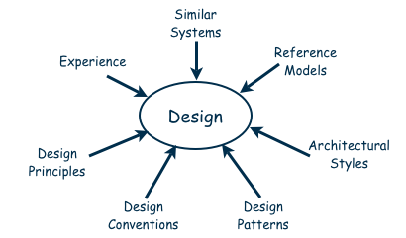
Sources of design advice (guidance in designing a new system)
P226, Figure5.2

Slide 7
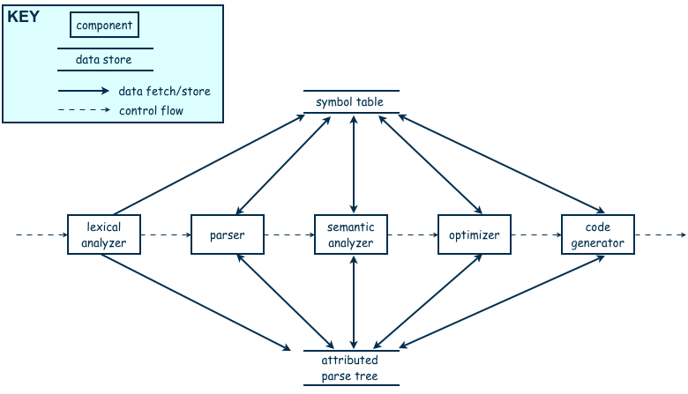
Sources of design advice (guidance in designing a new system)
Cloning
  Borrow design/code in its entirety, with minor adjustments
  Similar systems (Cloning)
Reference models（参考模型）
  A standard generic architecture for a particular application domain.
  Generic architecture that suggests how to decompose the system
  The reference models for a complier, P227, Figure 5.3, 编译器的参考模型
Notes:
Parser:语法分析器；lexical analyzer:词法分析器

Slide 8
Sources of design advice (guidance in designing a new system)
Architectural styles（结构模式，5.4节）
  give advice about how to decompose a problem into software units and how those units should interact with each other.
  Client-server (C/S结构);
  peer-to –peer(P2P结构);
  Layering(分层结构);
Design patterns（设计模式）
  Generic solutions for making lower-level design decisions about individual software modules or small collections of modules. 见第6章
  23种设计模式，工厂模式，单例模式，观察者模式等等

Slide 9
Sources of design advice (guidance in designing a new system)
Design conventions（设计惯例，设计公约）
  A collection of design decisions and advice that , taken together, promotes certain design qualities.
  For example, abstract data types (ADTs) are a design convention that encapsulates data representation and supports reusability.
Design principles（设计原理）
  Are descriptive characteristics of good design, rather than prescriptive advice about how to design.
  Modularity(模块化), 信息隐藏; 抽象
Experiences

Slide 10
Design process model
Design a software system is an iterative process, in which designers move back and forth among activities involving understanding the requirements, proposing possible solutions, testing aspects of a solution for feasibility, presenting possibilities(各种可能性) to the customers, and documenting the design for the programmers.
P229, Figure 5.4, process for developing a software architecture.

Slide 11
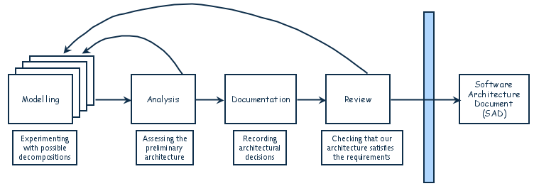
Design Process Model
Designing software system is an iterative process
The final outcome is the software architecture document (SAD)

Slide 12
5.2 modeling architectures
Architecture models can be use to（结构模型的用途）:
  Understand the system
  Determine how much of the system will reuse elements of previously built systems and how much of the system will be reusable in the future
  Provide a blueprint for constructing the system, including where the “load-bearing(承重)” parts of the system may be.
  Reason about how the system might evolve(演变), including performance, cost, and prototyping concerns
  Analyze dependencies and select the most appropriate design, implementation, and testing techniques
  Support management decisions and understand risks inherent in implementation and maintenance.

Slide 13
5.3 Decomposition and Views
In the past, software designers used decomposition as their primary tool, making a large problem more tractable by decomposing it into smaller pieces whose goals were easier to address. This approach is called “Top down”.
Today, many designers work on the architecture from the bottom up, packaging together small modules and components into a larger whole.
Decomposition process, P232, Figure 5.5

Slide 14
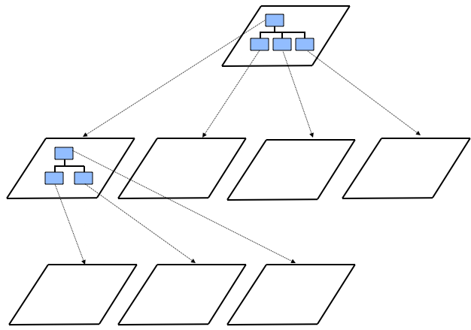
Decomposition and Views
Top
level
Top
level
First level of
decomposition
First level of
decomposition
Second level of
decomposition
Second level of
decomposition

Slide 15
Some popular design methods
Functional decomposition
  Partitioning functions or requirements into modules.
Feature-oriented design
Data-oriented decomposition
Process-oriented decomposition
Event-oriented decomposition
Object-oriented design
  Assigning objects to modules.

Slide 16
Software unit
No matter which design approach is used, the resulting design is likely to refer to several types of software units, such as component, subsystem, runtime process, module, class, package, library, or procedure.
Module
  a structural unit of the software’s code.
Component
  an identifiable runtime element.
Software unit
  a system’s composite parts without being precise about what type of part.

Slide 17
Architectural views（结构视图）
Decomposition view
  Portraying（描述） the system as programmable units.
Dependencies view
  Showing the dependencies among software units
Generalization view
  Showing software units that are generalizations or specializations of one another.
Execution view
  The traditional box-and arrow diagram that software architects draw, showing the runtime structure of a system in terms of its components and connectors.
Implementation view
  Mapping code units to the source file that contains their implementation.
Deployment
  Mapping runtime entities onto computer resource.
Work-assignment view
  Decomposing the system’s design into work tasks that can be assigned to project teams.

Slide 18
5.4 Architectural styles and strategies
Architectural styles
  Architectural styles are established, large-scale patterns of system structure.
Client-Server
Peer-to-Peer
Layering

Slide 19
5.4 Architectural styles and strategies
Client-server
  The design is divided into two types of components: clients and servers. Server component offer services, and clients access them using a request/reply protocol.
  The Client-server style supports reuse, in that servers providing common services may be useful in multiple applications.

Slide 20
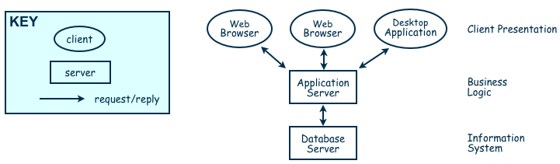
Three-tiered client-server architecture
Two types of components:
Server components offer services
  Clients access them using a request/reply protocol
Client may send the server an executable function, called a callback(回调函数，异步调用)
  The server subsequently calls under specific circumstances

Slide 21
Peer-to-peer
Peer-to-peer
  P2P architecture is one in which each component executes as its own process and acts as both a client of and a server to other peer components. Each component has an interface that specifies not only the services it provides, but also the services that it requests from other peer components.
  Any component can initiate a request to any other peer component.
  P2P networks are attractive because they scale up well.
  P2P network are also highly tolerant of component and network failures, because data are replicated and distributed over multiple peers.

Slide 22
Layering
Layered systems organize the system’s software units into layers, each of which provides services to the layer above it and acts as a client to the layer below. In a “pure” layered system, a software unit in a given layer can access only the other units in the same layer and services offered by the interface to the layer immediately below it.
Layer bridging: allowing a layer to access the services of layers below its lower neighbor
The layering system is useful whenever we can decompose our system’s functionality in steps, each of which builds on previous steps.

Slide 23
5.5 achieving quality attribute
When design the system, we should select architectural styles that promote the required quality attribute.
  Modifiability
  Performance
  Security
  Reliability
  Robustness
  Usability
  Business goals

Slide 24
Modifiability
Modifiability is essential, because we want our design to be easy to change.
Two classifications of affected software units:
  Directly affected
  Indirectly affected

Slide 25
Tactics for minimizing the number of software units directly affected
Tactics for minimizing the number of software units directly affected by a software change focus on clustering anticipated changes in the design. (把预计会变化的地方集中起来)
  Anticipate expected changes
    把预期会变化的隔离在单独的模块里
  Cohesion
    高内聚
  Generality
    更通用

Slide 26
Tactics for minimizing the impact on indirectly affected software units
Tactics for minimizing the impact on indirectly affected software units focus on reducing dependencies among software units.
  Coupling
    降低耦合
  Interface
    改变接口而不改变模块
  Multiple interface
    增加接口而不改变模块

Slide 27
performance
Performance attributes describe constraints on system speed and capacity, including:
  Response time
  Throughput
  Load
Tactics for improving system performance include:
  Improving the utilization of resource
    Make software more concurrent
  Managing resource allocation more effectively
    First-come/first-served
    Explicit priority
    Earliest deadline first
  Reducing demand for resources
    Reduce demand on resource by making our code more efficient

Slide 28
security
Immunity（免疫）
  A system has high immunity if it is able to thwart（挫败）an attempted attack.
  Ensuring that all security features are include in the design.
  Minimizing the security weaknesses that might be exploited by an attacker.
Resilience（可复原的）
  A system has high resilience if it can recover quickly and easily from a successful attack.
  Segmenting the functionality so that the effects of an attack can be contained to a small part of the system.
  Enabling the system to quickly restore functionality and performance in a short time.

Slide 29
reliability
A software system is reliable if it correctly performs its required functions under assumed conditions.
  Is the software internally free of errors?
A system is robust if it able to function correctly in the presence of invalid inputs or stressful environment conditions.
Reliability has to do with whether our software is internally free of errors, and robustness has to do with how well our software is able to withstand errors or surprises from its environment.

Slide 30
reliability
A fault is the result of human error, compared to a failure, which is an observable departure from required behaviour
  Software is made more reliable by preventing or tolerating faults
We make software more reliable by preventing or tolerating faults.
  Active fault detection
    We periodically check for symptoms（症状，征兆）of faults, or try to anticipate when failures will occur (比如统计执行时间，心跳程序)
    We include exception handling in our design
    Two computer running in parallel
  Passive fault detection
    wait until fault occurs during execution

Slide 31
reliability
Fault recovery
  A detected fault must be handled as soon as it is discovered, rather than waiting until processing is complete, which can help to limit the fault’s damage, rather than allowing the fault to become a failure.
  handling fault immediately to limit damage
  Fault-recovery tactics include:
    Undoing transactions
    Checkpoint/rollback
      software records a checkpoint of current state; rolls back to that point if system gets in trouble
    Backup
    Degraded service
      returns to previous state, offers degraded version of the service
    Correct and continue
    Report

Slide 32
robustness
A system is said to be robust if it includes mechanisms for accommodating（适应） or recovering from problem in the environment or in other units.
We can use a policy of mutual suspicion （互相怀疑）to design defensively. In mutual suspicion, each software unit assumes that the other units contain fault.
Robustness is dealing with the problems rising from software environment rather than software itself.

Slide 33
usability
Usability attribute reflect the ease with which a user is able to operate the system.
First, the user interface should separates itself from software units, which can makes it easier to customize the user interface for different audiences, while has no interfere to software’s function units.(界面和业务逻辑分离)
Second, there are some user-initiated commands that require architectural support, such as cancel, undo, show multiple views .The system need a process that listens fro these commands. （需要维护用户操作和系统状态）
Third, there are some system-initiated activities for which the system should maintain a model of its environment. The most obvious examples are time-activated activities that occur at defined time intervals or on specified date.（系统引发的活动应该维护环境模型）

Slide 34
Business goals
Business goals are often involving to minimize the cost of development and the time to market.
Buy vs. build
  Save development time, money
  More reliable
  Existing components places constraints on the rest of our design; vulnerable(脆弱) to supplier
Initial development costs vs. maintenance costs
  Save money by making system modifiable
  Increased complexity may delay release; lose market to competitors
new vs. known technologies.
  Acquiring expertise costs money, delays product release
  Either learn how to use the new technology or hire new personnel
  Eventually, we must develop the expertise ourselves

Slide 35
5.6 collaborative design
The design of software systems is usually performed by a team of developers, rather than by a single person. A design team works collaboratively, often by assigning different parts of the design to various people.
One of the major problems in performing collaborative design is addressing（解决，处理）differences in personal experience, understanding, and preference.
Another is that people sometimes behave differently in groups from the way they behave individually.

Slide 36
distributed development
Outsourcing（外包）
  For cutting costs, more software development activities will be outsourced to other companies or divisions. A collaborative design team may be distributed around the world.
Four stages in distributed development:
  Project performed at single site with on-site developers from foreign countries
  On-site analysts determine system requirements, which are in turn provided to off-site groups
  Off-site developers build generic products and components that are used worldwide
  Off-site developers build products that take advantage of their individual areas of expertise

Slide 37
5.8 Documenting software architectures
The SAD serves as a repository for information about the architectural design and helps to communicate this vision to the various members of the development team.
A SAD should include the following information:
  System overview(系统综述)
  Views(各种视图), P234-235
  Software units
  Analysis data and results
  Design rationale（逻辑依据）
  Definitions, glossary, acronyms（缩略词）

Slide 38
Mapping among views
The SAD should contain decomposition view(分解视图) showing the design’s constituent （构成的）code units, plus an execution view(执行视图) showing the system’s runtime structure. A deployment view(部署视图) that assigns software units to computing sources is essential.
Our design is documented as a collection of views, we should show how the views relate to one another. For example, it is useful to record how runtime components and connectors in an execution view map to code-level units in a decomposition view.
Clements（2003）describes how to document a mapping between two views as a table, indexed by the elements in one of the views.

Slide 39
Documenting rationale
Documenting rationale is to outline the critical issues and trade-offs（权衡,协调） that were considered in generating the design . This guiding philosophy helps the customers, project managers, and other developers（particularly maintainers） understand how and why certain parts of design fit together. it also helps the architect remember the basis for certain decisions.
Rationale is usually expressed in terms of the system’s requirements , such as design constraints that limit the solution space, or quality attribute to be optimized.

Slide 40
Documenting rationale
When to document the rationale behind decision:
  Significant time spent on decision
  Decision is critical
  Decision is counterintuitive(违反直觉，不好理解)
  Costly to change decision

Slide 41
5.9 Architecture design review
Design review is an essential part of engineering practice
We evaluate the quality of a SAD in two different ways.
  First, we make sure that the design satisfied all of the requirements specified by the customer. This procedure is known as validating the design.（is the right system）
  Then we address the quality of the design, verification involves ensuring that the design adheres to good design principles, and that the design documentation fits the needs of its user. （building the system right?）

Slide 42
validation
We make sure that all aspects of the requirements are addressed by our design, we invite several key people to the review:
  analyst
  system architect
  program designer
  system tester
  system maintainer
  moderator（主持人，仲裁人，调解人）,
  recorder
  other interested system developers who are not otherwise involved in this project.

Slide 43
validation
Any discrepancies(差异，矛盾，出入) found during the review are noted by the recorder and discussed by the review group as a whole. If major faults or misunderstandings arise, we may agree to revise the design.

Slide 44
verification
In verification, we evaluate the quality of the design and the documentation, we examine the design to judge whether it adheres to good design principles:
  Is the architecture modular, well structured, and easy to understand?
  Can we improve the structure and understandability of the architecture?
  Is the architecture portable to other platforms?
  Are aspects of the architecture reusable?
  Does the architecture support ease of testing?
  Does the architecture maximize performance, where appropriate?
  Does the architecture incorporate appropriate techniques for handling faults and preventing failures?
  Can the architecture accommodate all of the expected design changes and extensions that have been documented?

Slide 45
Active design review
active design review
  reviewers exercise the design document by using it in ways that developers will use the final document in practice.
passive review process
  reading the documentation and looking for problems.

